Slide 1

22.04.01 Materials Science and Engineering
DFT study of hydroxyl defects
in LiFePO₄ and LiMnPO₄ cathode materials
Student: Irina Varlamova
Research Advisor: Andriy Zhugayevych
Co-Advisor: Dmitry Aksenov
10 June, 2020

Slide 2
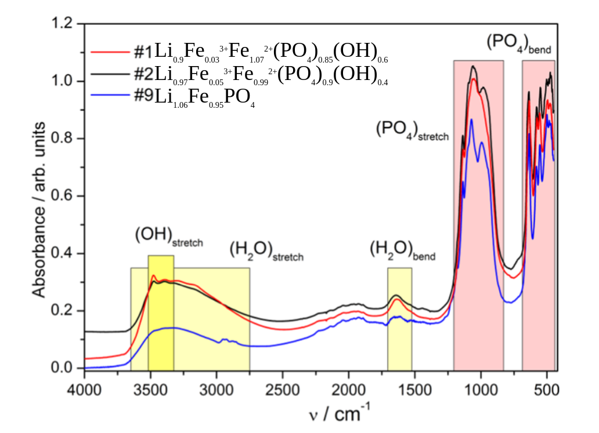
Motivation
IR
Positive electrode (cathode) in Li-ion batteries - Li(Fe, Mn)PO₄
MSU and Skoltech experimentalists [1]:
Obtained with hydrothermal synthesis from water solution
PXRD and Neutron Diffraction analysis - Li_{0.93}Fe_{1.07}P_{0.84}O₄
Infrared spectrum investigation showed OH peak
But the structure of OH defects remains unknown
?
What is the structure of
hydroxyl point defects
2
[1] Sumanov, V. D., Aksyonov, D. A., Drozhzhin, O. A., et.al. Chem.Mat., no.14(2019) 5035-5046.
Notes:
Lithium iron phosphate is a widely used cathode material for the modern batteries, while lithium manganese phosphate is a prospective cathode material due to its high voltage. However it has low cycle stability. Recently the experiment with hydrothermal synthesis in water environment and investigation of properties were held. The electron diffraction analysis shows the deficiency of phosphorus. Infrared spectroscopy shows the weak peak of OH-bond within structure for non-concentrated solutions of samples (fig). But hydrogen bond presence in LiFePO4 is unknown and the structure of such defect has not been investigated yet. So, the main question of work is “What is the structure of hydroxyl point defects?”

Slide 3
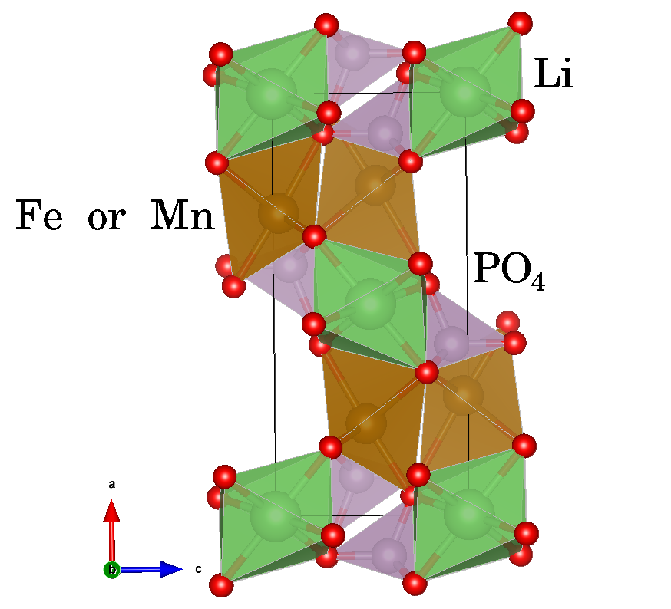
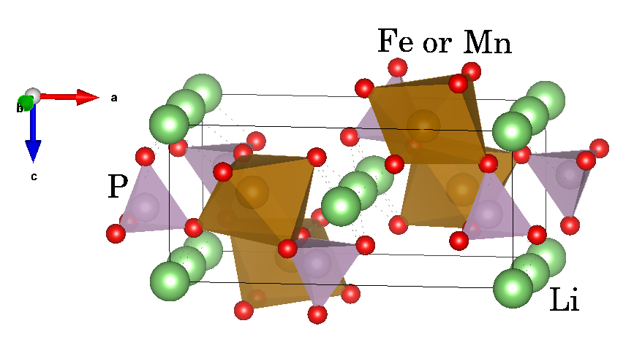
Structure under study
Tryphylite type structure with Pmna space group, similar to olivine (Mg²⁺, Fe²⁺)₂SiO₄
3
Notes:
On this slide the schematic view of the structure under study is presented. The iron (or manganese) atom is located in octahedral environment of oxygen and has a brown color, phosphorus atom is located in tetrahedral environment of oxygen with purple color. The migration path of lithium during charge/discharge process is through b-axes, green color. Additionally, there are void polyhedral sites, which will be shown later.

Slide 4
Aim and objectives
Aim
To determine the structure and formation energy of OH defects in Li(Fe,Mn)PO₄ using density functional theory (DFT)
Objectives:
To study:
the energy and structure of OH defect in the tetrahedral and octahedral voids;
the energy and structure of Li/H and Fe/2H substitution defects;
the energy and structure of PO₄/(OH)₄ substitution defects;
the dynamics of OH defects in LiFePO₄ at elevated temperatures
4
Notes:
So, the main goal of current work is to determine the hydrogen defects structure in Li(Fe,Mn)PO₄ using DFT approach. The main task is to study the energy and structure of OH defect in the void tetrahedral and octahedral sites and of Li/H and Fe/2H and PO₄/(OH)₄ substitution defects. Also the dynamics of OH defects at elevated temperatures was provided

Slide 5

Methods
Aim | Calculation methods
Electronic structure | Density Functional Theory (DFT)
Atomic structure | PBE, 400 eV, k-spacing 0.3 A⁻¹ in VASP package
 | Atomic and shape optimization at 7 fixed volumes [1]
Structure of OH defects | Potential energy scan (PES) on grid
Dynamics of OH defects | Ab-initio Molecular Dynamics in VASP up to 10ps
Deintercalation potential | Cluster expansion method (CLEASE software) [2] and enumerative scan of Li-vacancies
SIMAN
PYTHON BASED FRAMEWORK
[1] https://github.com/dimonaks/siman/wiki.
[2] Chang, J. H., Kleiven, D., et.al. Journal of Physics: Condensed Matter, no.31(2019), 325901.
5
Notes:
The detection of hydrogen defects within lithium iron phosphate structure is difficult, the DFT method of study is used for this investigation. The python based framework of SIMAN was used to prepare calculations and provide their postprocessing. The calculations of DFT models are provided in the VASP code. Volume scan method was used to find the lattice constant. We used the method of potential energy surface scan based on SIMAN to identify hydrogen positions. Also the evolution of the system with high temperature was calculated using molecular dynamics method. At first, deintercalation process of lithium was investigated using CLEASE method of DTU energy developers. However, it was difficult for calculation due to the absence of convergence, and the study continued with SIMAN package, generating a set of structures with Li vacancies.

Slide 6
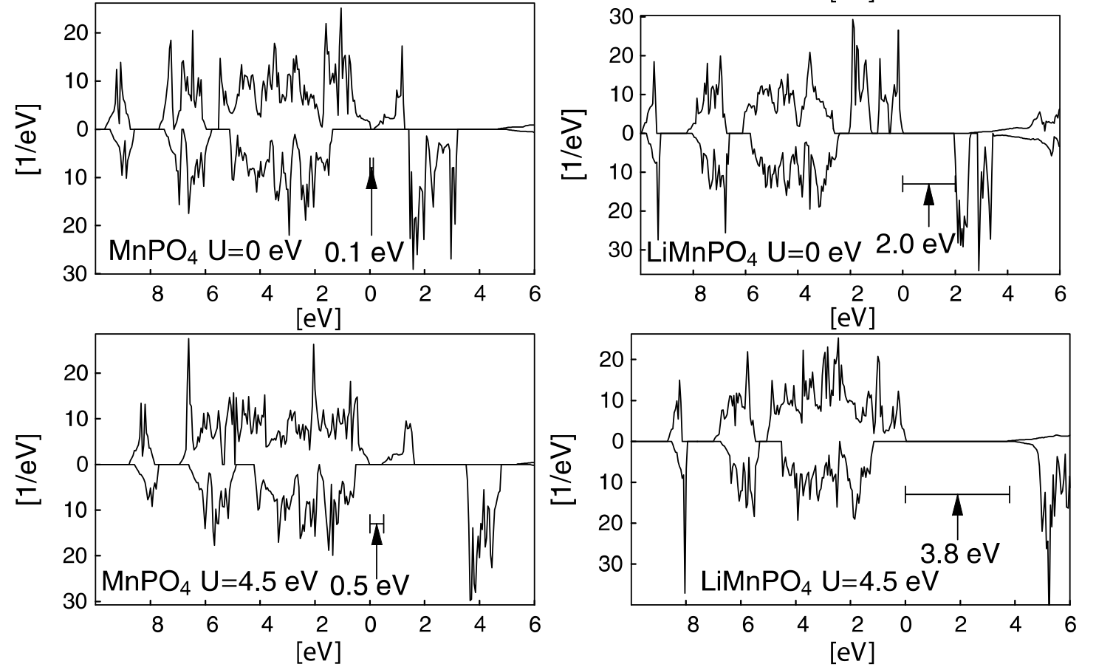
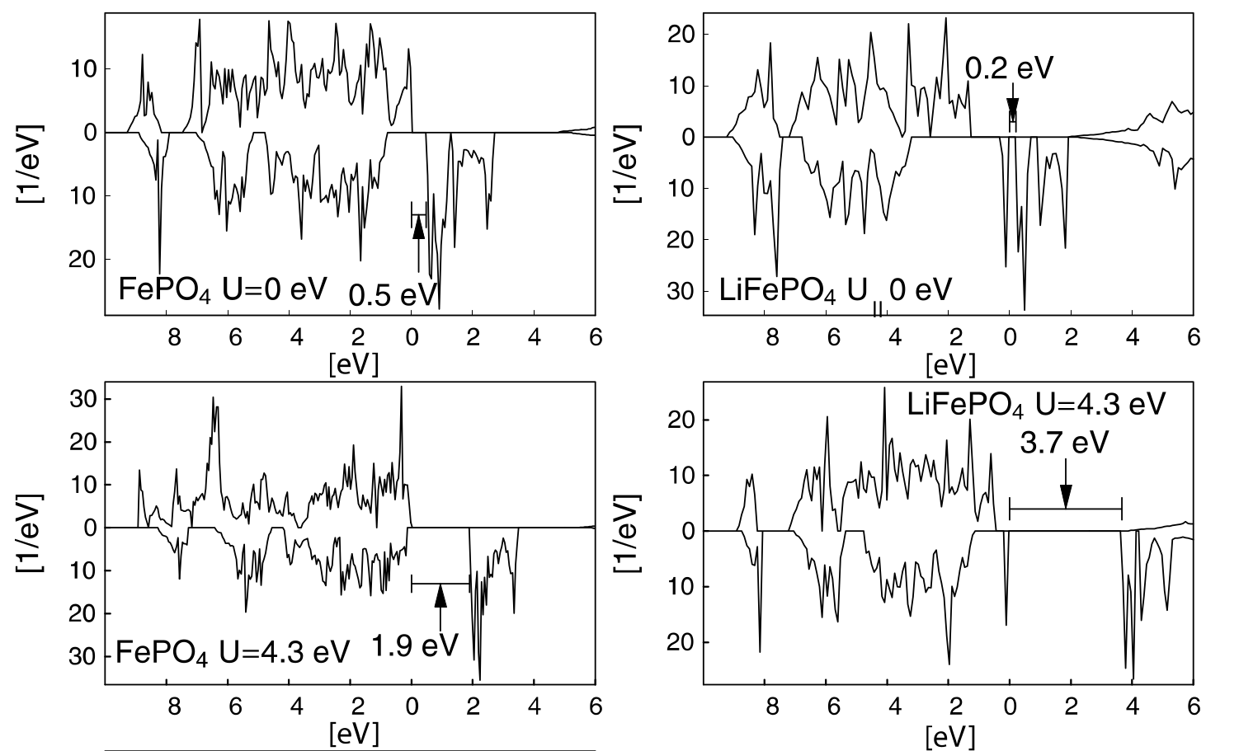
Li(Fe,Mn)PO₄: structure and electronic properties
LiFePO₄
 | Current | Ref.
a, Å | 10.33 | 10.32 [1]
b, Å | 6.01 | 6.01 [1]
c, Å | 4.73 | 4.69 [1]
Voltage, V |  | 3.4[2]
LiMnPO₄
 | Current | Ref.
a, Å | 10.56 | 10.45 [1]
b, Å | 6.15 | 6.10 [1]
c, Å | 4.79 | 4.74 [1]
Voltage, V |  | 4.1[2]
Tryphylite type structure with Pmna space group, similar to olivine (Mg²⁺, Fe²⁺)₂SiO₄
[1] Urusova V , Semkin MA, et al. Ferroelectrics, 509(2017):74–79
[2] Li, G., Azuma, H., et.al. Electrochem. and Solid State Lett.no.5 (2002) A135.
6
Notes:
Both materials have a triphilite structure, which is quite similar to the olivine group. Minerals of this group are common materials of earth mantle. Forsterite is more investigated and is a widely studied material in terms of defects presence. The calculations of the current work with GGA-PBE potential and the reference values of lattice parameters are presented in the tables. According to this comparison, the structure characteristics can be successfully predicted in GGA approximation.

Slide 7
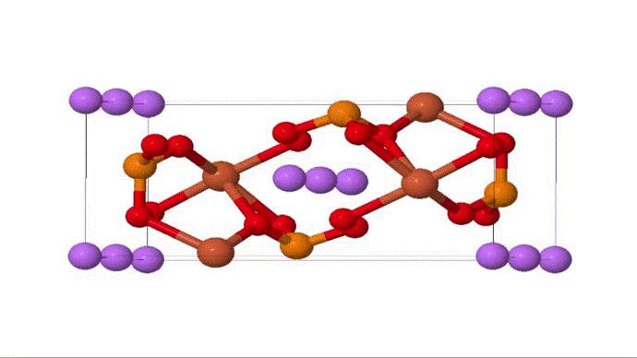
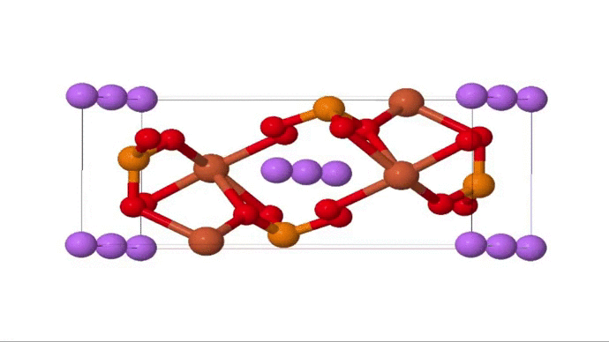
Structure of LiFePO₄ and P vacancy
(hydrogen goes into tetrahedral voids)
Unit cell of LiFePO₄ in polyhedral representation → different nonequivalent positions of interstitial or substitutional hydrogen defects
7
Notes:
The unit cell of lithium iron phosphate has the structure, which is presented on this slide. This structure in polyhedral representation has 8 octahedral sites of Li and Fe in oxygen environment and 4 tetrahedral sites of P positions. As it will be important for further narration, I will consider the environment of this P: it will be 5 iron octahedral and 4 lithium octahedral and several empty regions. Thus, using this structural information we can consider possible positions of H defect within structure.

Slide 8
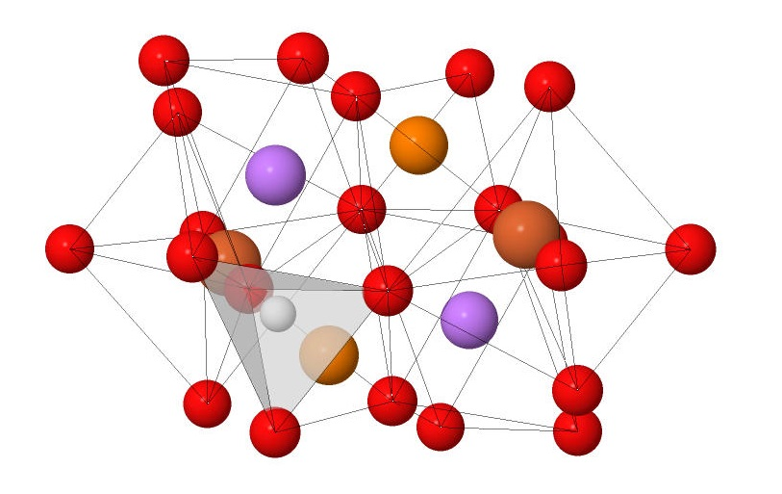
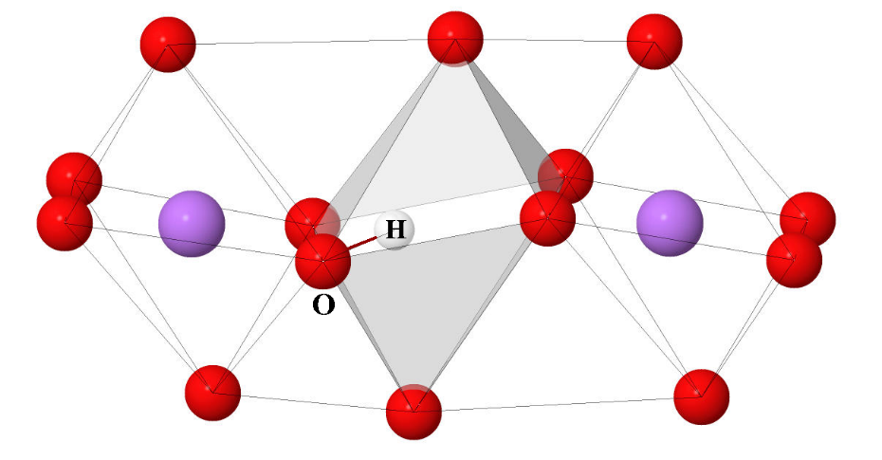
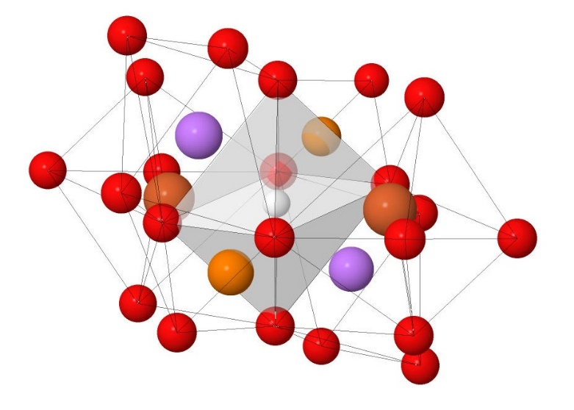
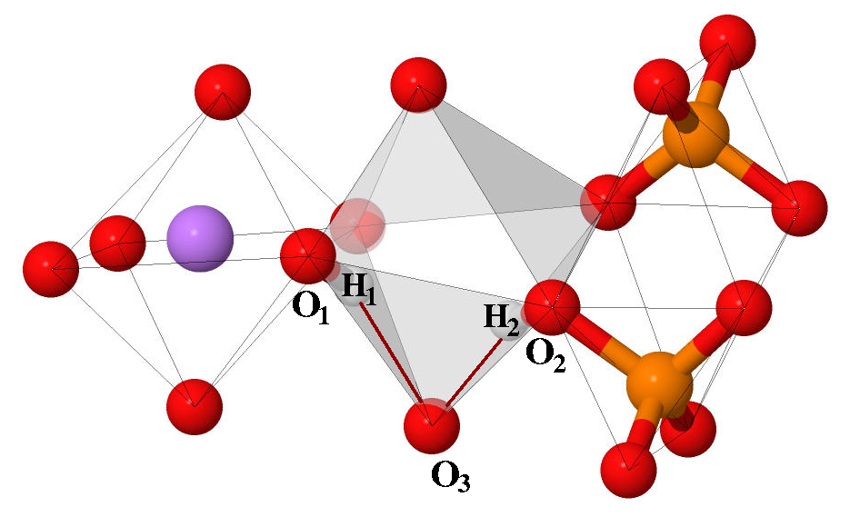
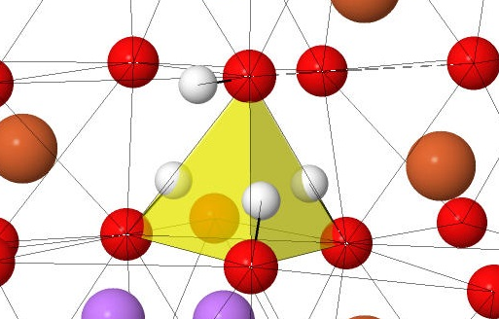
Types of OH defects in LiFePO₄
Interstitial H in
tetrahedral void
Interstitial H in
octahedral void
Substitution of Li by H
2.76 eV
0.89 eV
2.96 eV
Substitution of Fe by 2H
P vacancy site
Li(Fe,Mn)PO₄ with 25% OH
0.88 eV
PO₄/(OH) ₄ 0.53 eV
More stable from:
Mössbauer analysis
Comparison with other defects
Comparison with PO₄/O_{x}H₄ (x<4)
8
Notes:
Many localization options of OH bond can be found within LFP structure. Interstitial H defect can be localized in the void octahedral or tetrahedral site. Additionally, the substitution of Li, Fe or P by hydrogen can be observed. All interstitial defects and substitution of Li or Fe by Hydrogen provided high formation energy and non-stable structure. In this work we will consider the substitution of P by four H defects.

Slide 9
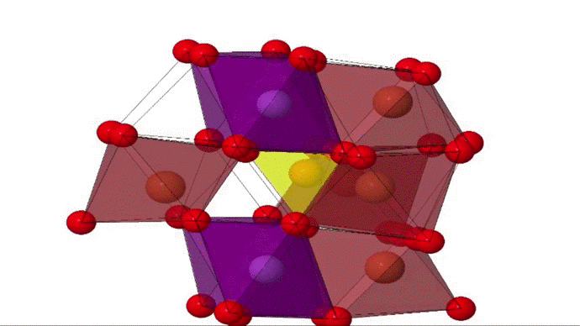



Structure of OH defects in Li(Fe,Mn)PO₄
HIGH
Energy
(16.3 eV)
LOW
Energy
(-1.5 eV)
9
Notes:
On this slide the representative of Potential Energy Surface scan method is shown. The central yellow area is a phosphorus vacancy tetrahedral site. The hydrogen positions relative to each of oxygen atoms were considered as a cloud in the general view. The color of each hydrogen position corresponds to its formation energy. The dark blue color is a more prospective position, which is chosen for the next step of PES. Choosing the low energetic position for each step, we found the most stable configuration and, as a result the stable defective structure.

Slide 10
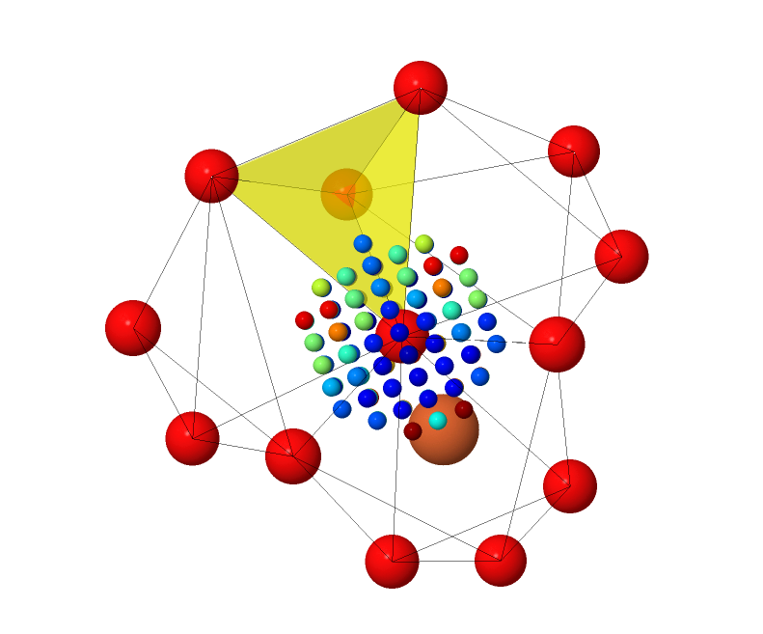
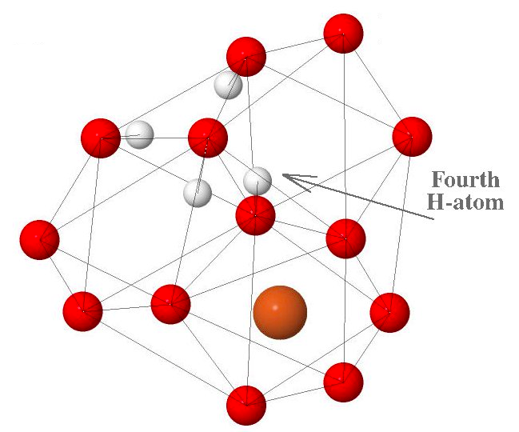
Structure of LiFePO₄ with H defects
Initial structure
Final structure
Unit cell of LiFePO₄ with 25% OH with phosphorus vacancy on tetrahedral site LiFePO₄ was created
There were four stages of the hydrogen distribution study: around each of oxygen in the phosphorus vacancy site (yellow triangle)
10
Notes:
After PES process, the equilibrium positions of hydrogen defects within phosphorus vacancy site was found. Structures with this localizations of hydrogen atoms have the smallest energy after relaxation and can be considered as an equilibrium. The next slide demonstrates three possible configurations.

Slide 11
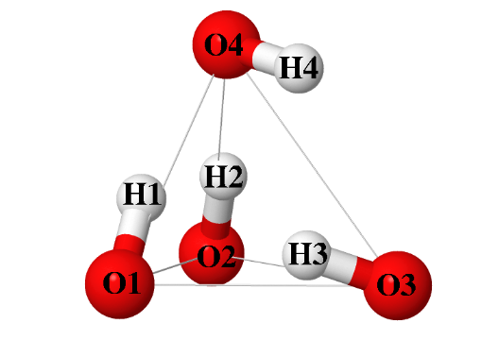
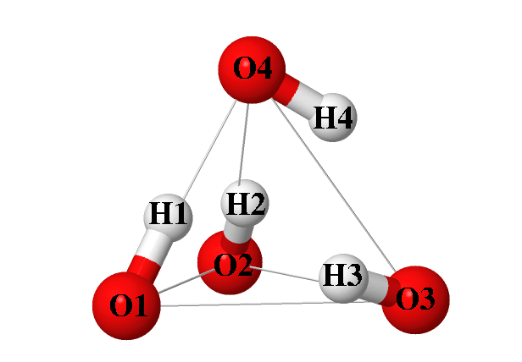
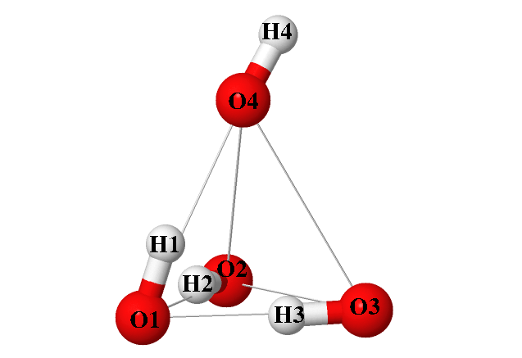
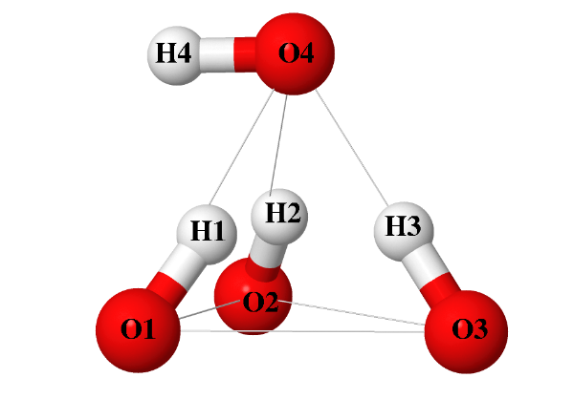
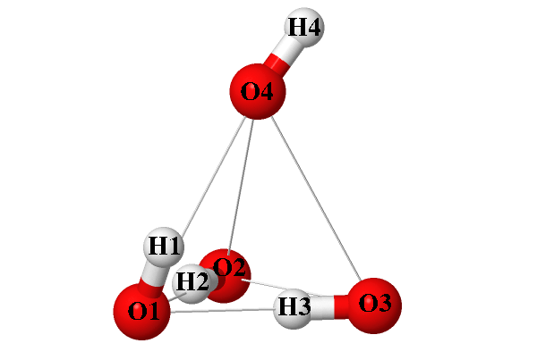
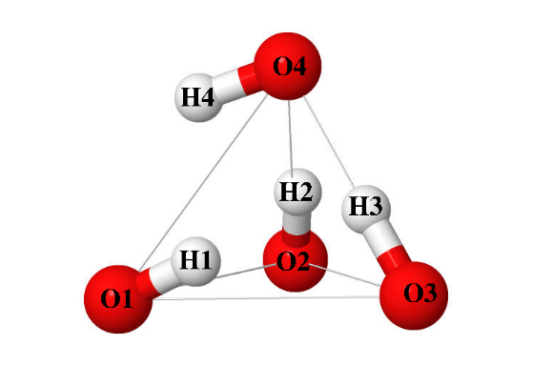

Structure of Li(Fe,Mn)PO₄ with H defects
E, eV
LiMnPO₄
LiFePO₄
LiMnPO₄
LiFePO₄
1.22
0.08
0.98 Å
0.99 Å
1.77 Å
2.21 Å
1.82 Å
0.1
0.02
0.99 Å
0.99 Å
1.00 Å
0.98 Å
1.85 Å
1.00 Å
0
0
11
PES method shown possible configurations of OH defects within Li(Fe,Mn)PO₄
Notes:
The same PES study of hydrogen position within phosphorus defective tetrahedral site was provided also for LiMnPO4. The three possible low energetic structures of Li(Fe and Mn)Phosphate with substitution of phosphorus by four hydrogen are presented on this slide. The main result is that each hydrogen creates the covalent 1A bond with its neighboring oxygen. Three of hydrogen atoms are localized in the vacancy tetrahedron when fourth hydrogen atom is located outside of vacancy site.

Slide 12
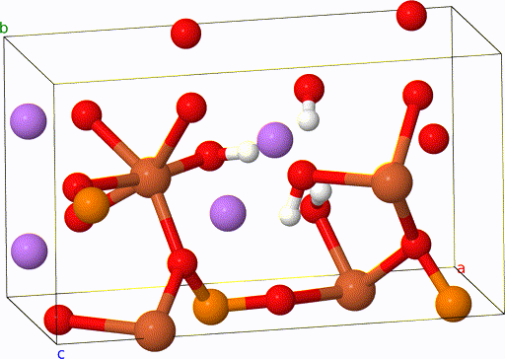
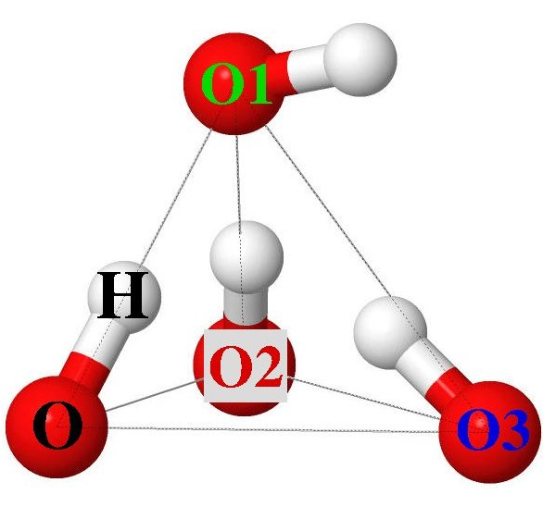

Dynamics of OH defects in LiFePO₄, 600 °C, 2ps
The evolution of O-H distance over time
Each color is corresponded to each of the four OH groups in the tetrahedron.
Also Molecular dynamics investigation:
T = 100, 400, 600, 800 °C
T = 600 °C – annealing
Stable OH covalent bond and the absence of its breaking were observed.
Molecular Dynamics study is necessary for complete investigation of possible PO₄/(OH)₄ defects configuration
13
Notes:
Molecular dynamics of evolution of hydrogen defects within LFP with 25% of defects structure was provided. Temperature of MD investigation was chosen according to the annealing process in the synthesis conditions. In this case it is approximately 600°C. For this temperature we observed the change of defective structure with time.

Slide 13
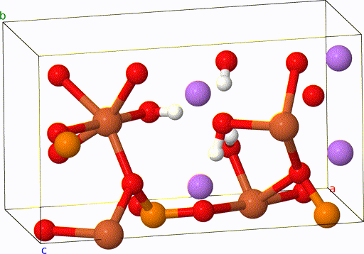
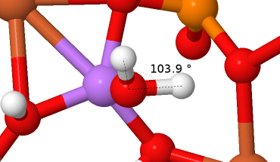

Dynamics of OH defects in LiFePO₄, 1100 °C, 2ps
Though this is temperature is too high compared to experiment, it allows to reduce the simulation time
Such result is relevant requires longer simulation and calculations of barriers
Formation of temporal H₂O molecule
(50% times)
14

Slide 14
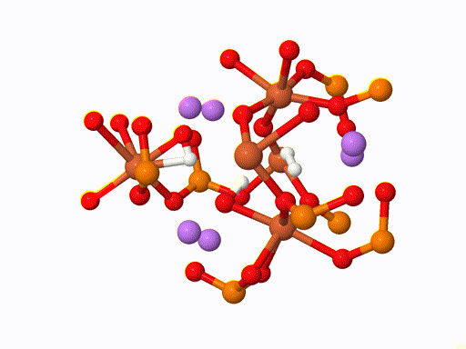
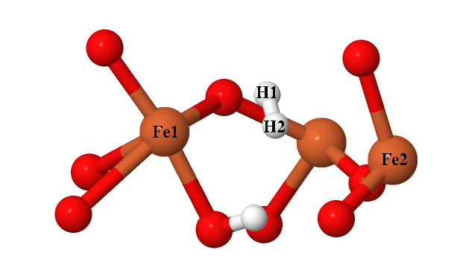

Evolution of OH defects in LiFePO₄, 600 °C
Such result requires longer simulation and calculations of barriers
Formation of H₂ molecule
H-H distance 0.7 Å
15
Notes:
Additionally, we provided the MD study with 6.25% of defect concentration, where the existing of H2 molecule was observed also after relaxation of structure with 0K. This is an interesting result, which will be taken into account in the further investigation of energy barriers of h defects.

Slide 15
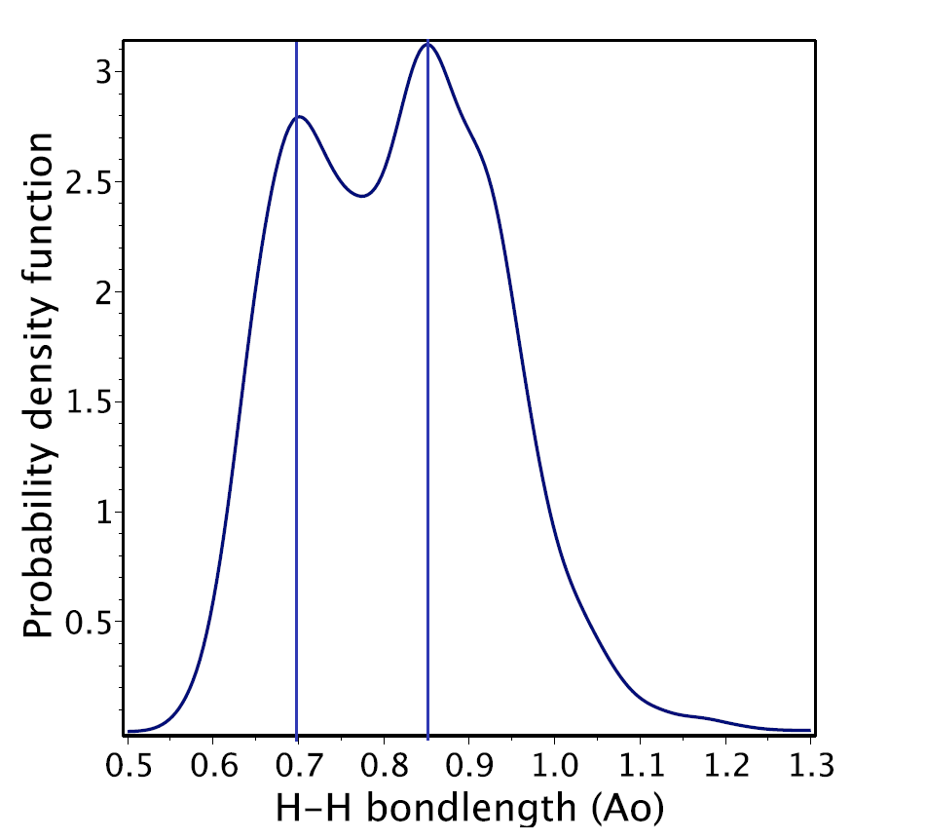
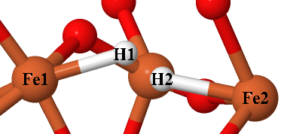
Evolution of OH defects in LiFePO₄
O-H distances, Å
Hydrogen atom always forms a covalent bond with oxygen with 1Å length
O1-H
O2-H
O3-H
H-H 0.85 Å
H-H 0.70 Å
The hydrogen molecule H₂ is observed with bond length corresponding to vacuum value (0.74Å)
16
Notes:
The evolution of hydroxyl defect at the certain temperature shows the existence of hydrogen bond with the neighboring oxygen. In the first diagram the conclusion about the absence of free hydrogen atom in the structure can be made. Each hydrogen atom always constructs the bond either with neighboring oxygen. On the other hand, the hydrogen atom can create the bond with Fe or the second H. These bonds are confirmed by H-H distance diagram, where the distance between two hydrogen atoms is equal 0.7 A, which corresponds to H2 molecule, and 0.85A, which corresponds to the H-Fe bond.

Slide 16
Conclusion
Main results:
The energy and structure of interstitial H as well as substitutional Li/H, Fe/2H, and PO₄/(OH) ₄ defects in Li(Fe,Mn)PO₄ were determined with DFT calculations.
The PO₄/(OH) ₄ defect has the lowest formation energy per H atom among all considered defects.
In PO₄/(OH) ₄ defect four H atoms form covalent bonds (~1 Å) with O. Three OH bonds are directed inside the O₄-tetrahedral void left after P removal, while the fourth OH is located in the neighborhood void tetrahedral site.
The stability of PO₄/(OH) ₄ defects was confirmed with ab initio molecular dynamics at temperatures up to 600 ℃.
At 600 ℃ temporal formation of H₂ complexes inside PO₄/(OH) ₄ defects was observed.
17

Slide 17
19
Acknowledgements
I express my gratitude to
Dmitry Aksenov
and
Andriy Zhugayevych
for their support and advice
18

Slide 18
Thank you for your attention!

Slide 19
Defects formation energy calculation (GGA+U)
General formula:
$$E\left(def\right)=\frac{1}{n}\left[E\left(LiFePO_{4}def\right)−E\left(LiFePO_{4}\right)+μ\left(vac\right)−nμ\left(H\right)\right]$$
U (Fe) = 4.0 eV
Defect type | E_{form} (GGA) | E_{form} (GGA+U)
Li/1H | 0.38 | 0.89
Fe/2H | 0.50 | 0.88
P/4H | 0.51 | 0.53
P/5H | 0.89 | 0.73
A1

Slide 20
Different defect concentration values
Concentration of PO₄/(OH)₄ | E_{form}, eV
25% | 0.47
6.25% | 0.55
A2

Slide 21
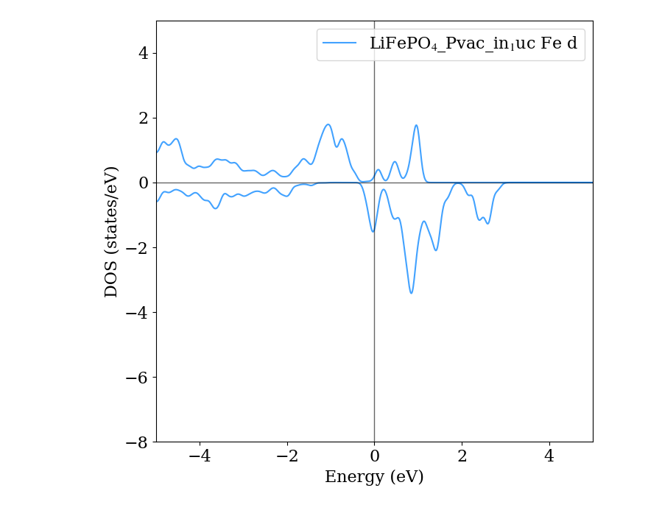
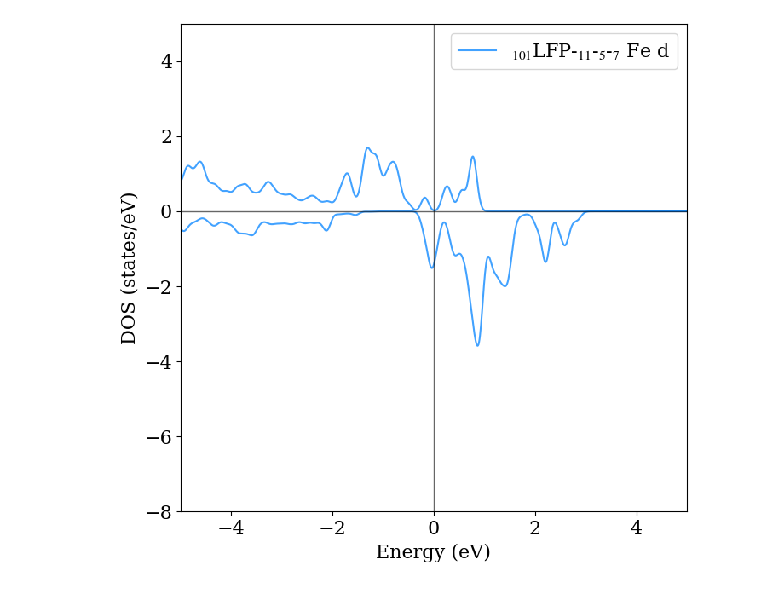
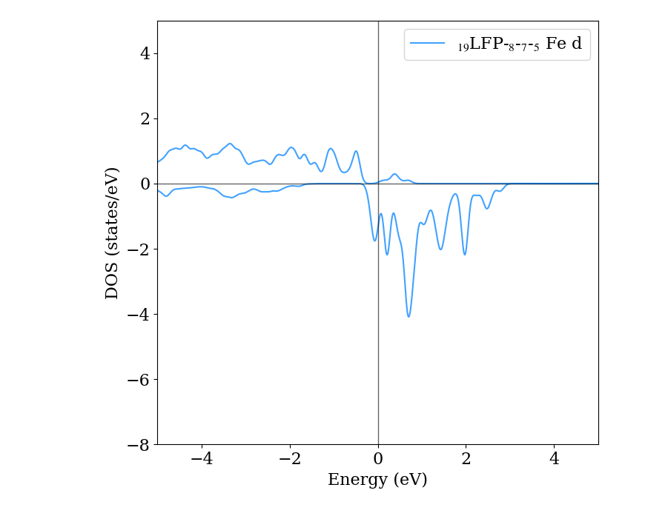
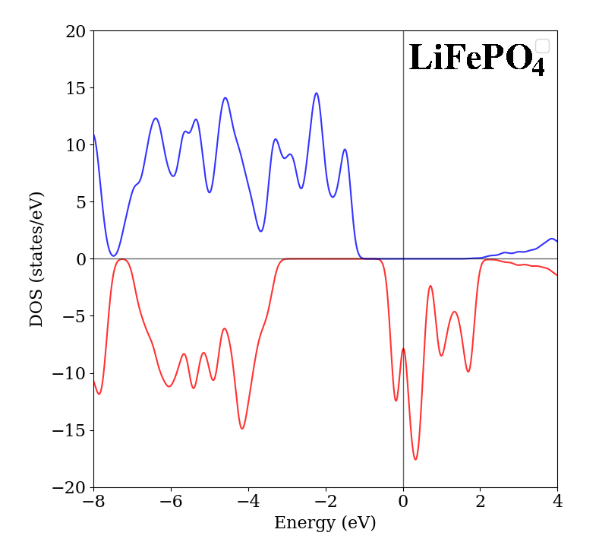
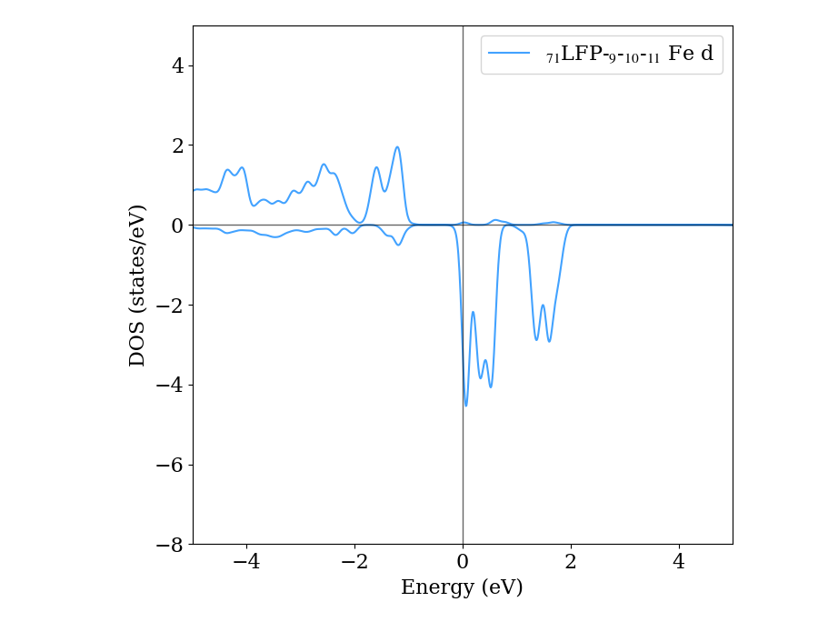
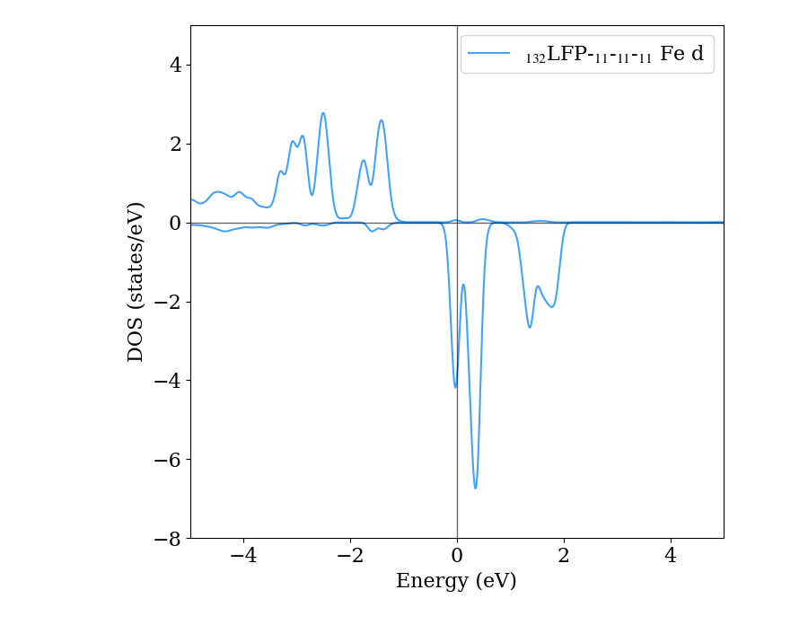
Electronic properties of LiFePO₄ with PO₄/O₄H_{x} defects
LiFePO₄ with P vacancy
PO₄/O₄H₁ defect
PO₄/O₄H₂ defect
The influence of substitution phosphorus by 1, 2, 3 or 4 hydrogen atom to electronic structure is presented in the following DOS diagrams. The absence of band-gap at the Fermi level can be observed, which shows the conductive features of defective material.
PO₄/O₄H₃ defect
PO₄/O₄H₄ defect

Slide 22
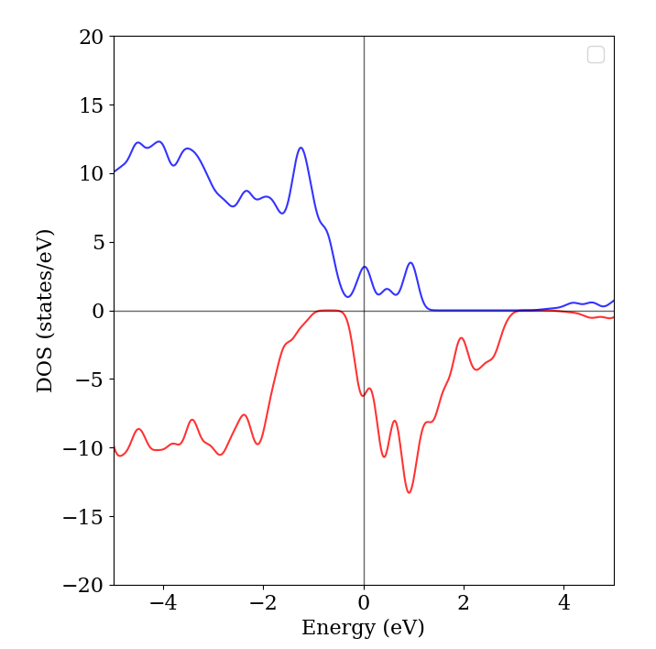
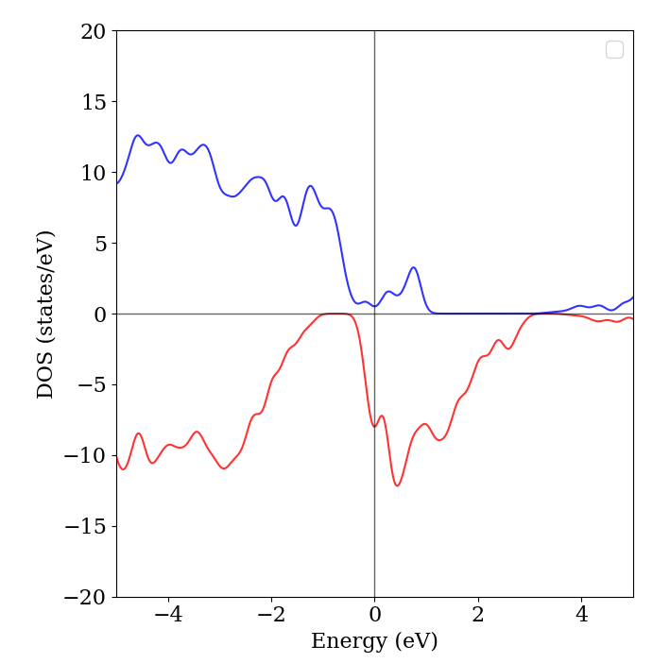
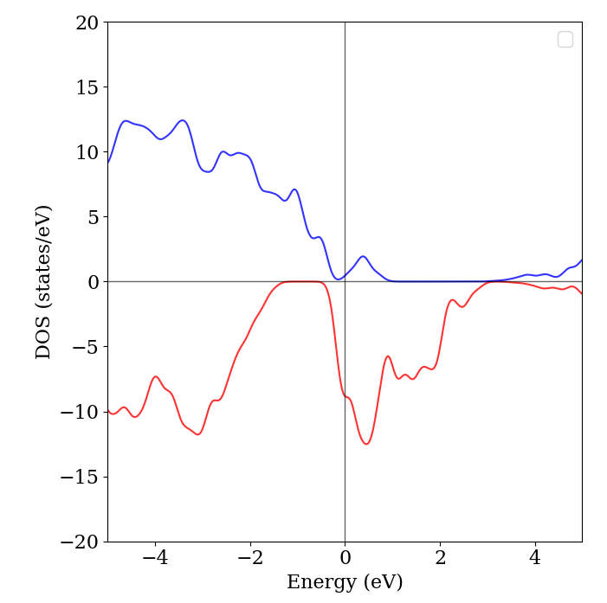
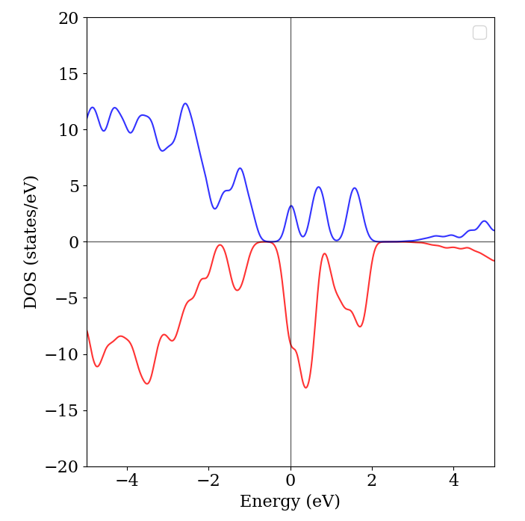
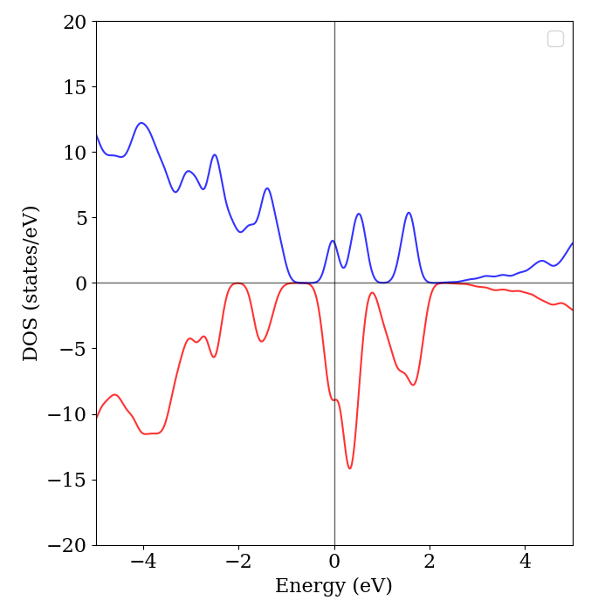
Electronic properties of LiFePO₄ with PO₄/O₄H_{x} defects 6,25%
LiFePO₄ with P vacancy
PO₄/O₄H₁ defect
PO₄/O₄H₂ defect
PO₄/O₄H₃ defect
PO₄/O₄H₄ defect
The influence of substitution phosphorus by 1, 2, 3 or 4 hydrogen atom to electronic structure is presented in the following DOS diagrams. The absence of band-gap at the Fermi level can be observed, which shows the conductive features of defective material.
A3
Notes:
Influence of hydrogen defect to intercalation process of Li is important in case of electrochemical application. When deintercalation potential of Li atom from pure LFP material is approximately 4.07 eV the decrease of such potential can be observed with presence of hydrogen defects in distance between phosphorus vacancy and li vacancy approximately 5A. Thus, we can define the influence of hydrogen defects for intercalation process of lfp.

Slide 23
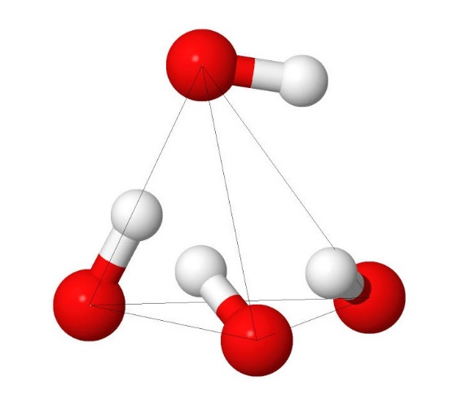
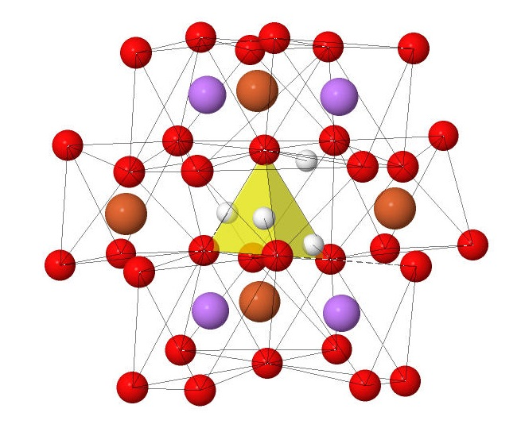
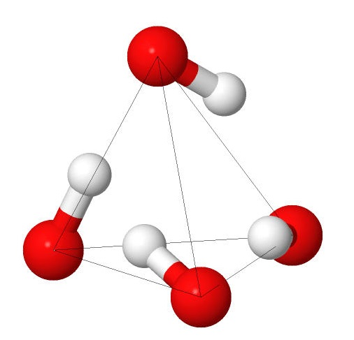
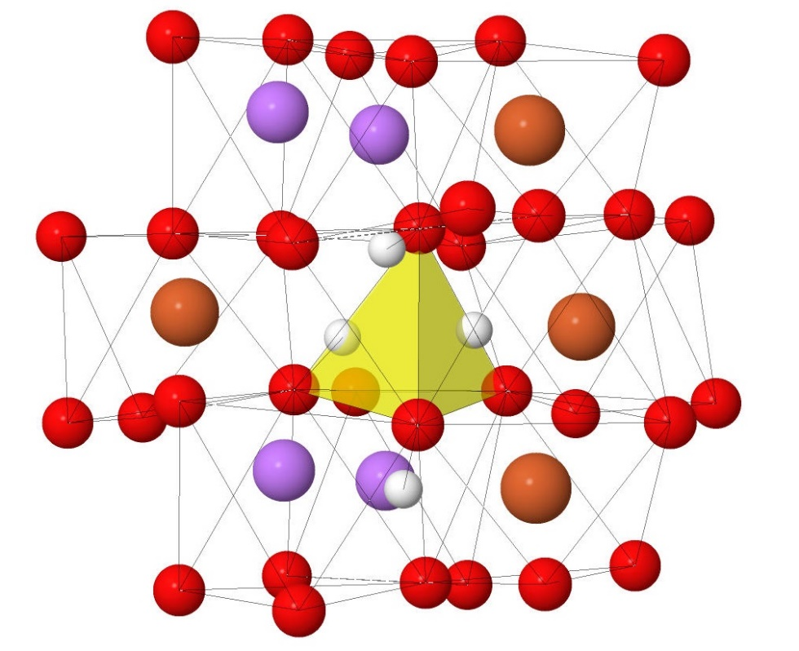
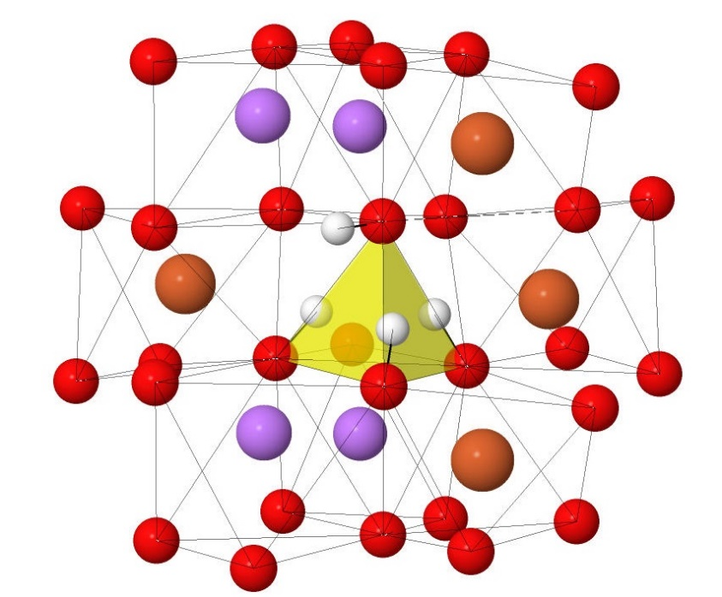
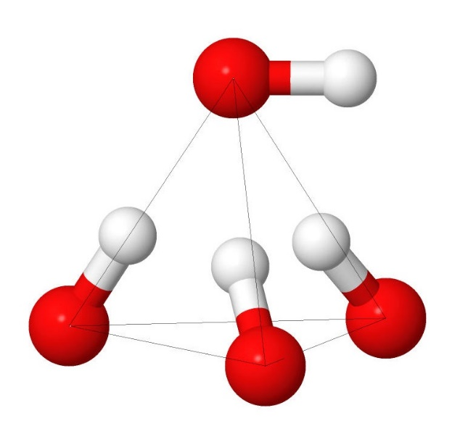
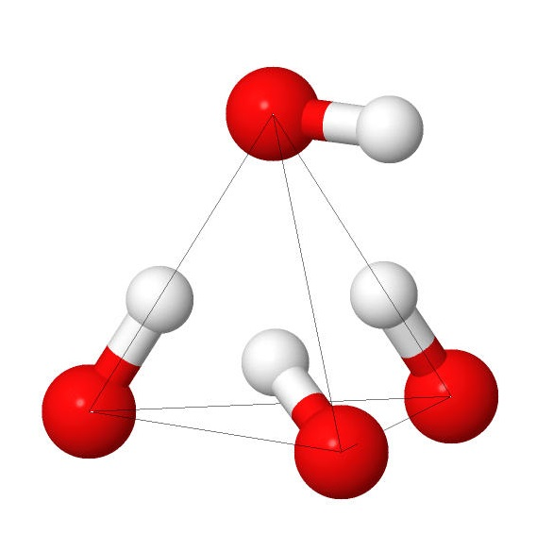
Addition configurations of defect from MD
PES results
MD study results
E, eV
-201.4
-201.28
-201.8
-202.51
-202.3
-202.50
14
Notes:
But now, using results after MD study, we found several type of stable positions of hydrogen within LFP and the conclusion about repeat of previous PES result can be clear seen, then new structures of defects are also observed.

Slide 24
Discussion of results 1
PES method shown possible configurations of OH defects within Li(Fe,Mn)PO₄
Structures of PO4/(OH)4 defects are similar with SiO4/(OH)4 Mg2SiO4 forsterite *
(Results of PES application are in good agreement with references [1])
Molecular Dynamics study is necessary for complete investigation of possible PO₄/(OH)₄ defects configuration
15
[1] Qin, Tian, et al. ”Ab initio study of water speciation in forsterite.” APS Meeting Abstracts. 2018.

Slide 25
Discussion of OH dynamics
Comparison of results between PES and MD study provided following conclusions:
MD investigation showed the same structure with minimum of energy as PES
Additionally, MD study provided new configuration of PO₄/(OH)₄ defects with simple low-energy characteristic
High-temperature simulation showed configurations with water ??? molecule within structure
16

Slide 26
18
The following parts should be accomplished
Thermodynamic analysis of all possible substitution and interstitial defects
the influence of PO₄/(OH)₄ defects on electronic structure;
Longer MD runs at 600 C
the influence of PO₄/(OH)₄ defects on hydrogen migration in LiFePO₄;
the interaction between substitution of P by 4 H and electronic structure:
the absence of band-gap at the Fermi level

Slide 27
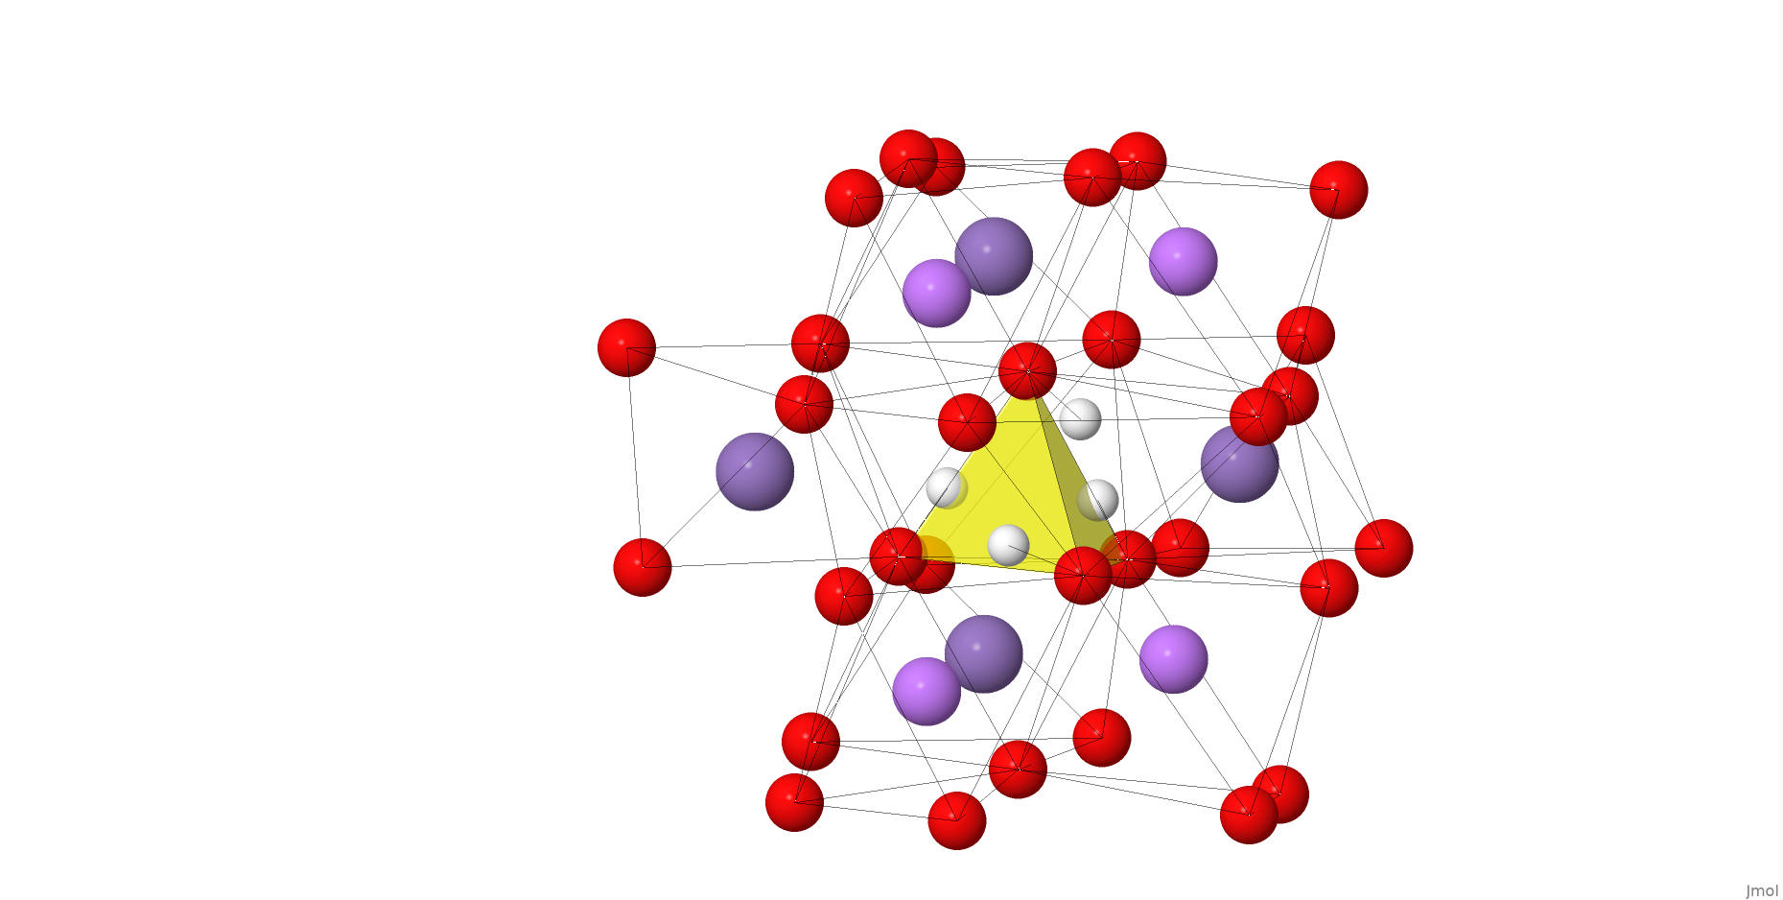
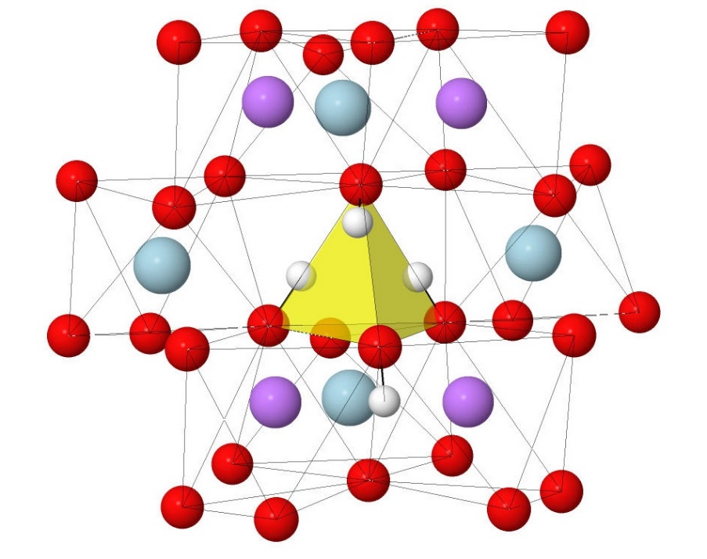
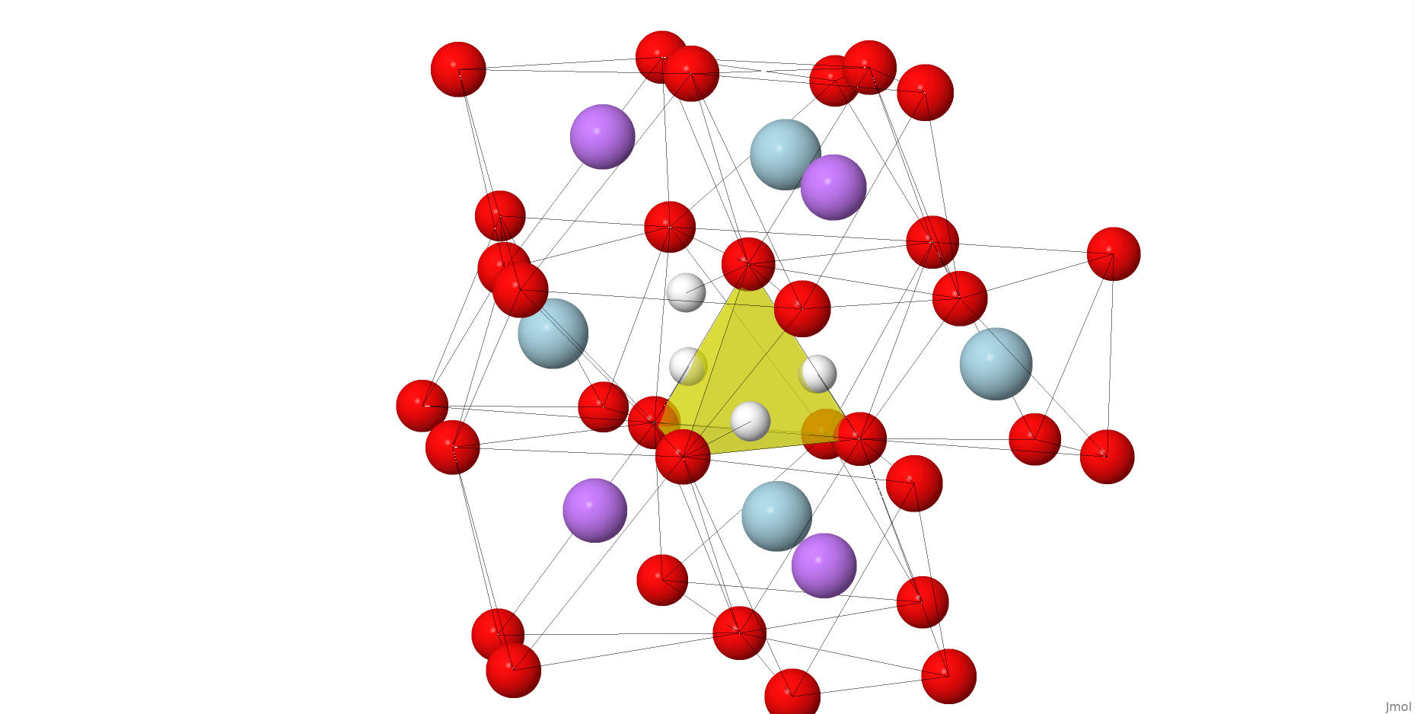
Most stable PO₄/(OH)₄ defects obtained after adding 4th H
LiFePO₄
E, eV
LiMnPO₄
1.22
0.08
0.1
0.02
0
0
12
Structures of PO₄/(OH) ₄ defects are similar with SiO₄/(OH) ₄ Mg₂SiO₄ forsterite
Notes:
This slide provides the information about localization of hydrogen substitution defects within phosphorus defective tetrahedral. After PES process the 3 structures of LFP and 3 structures of LMP were chosen. And, using this information, some intermediate conclusions can be made.

